Slide 1
“THEORY OF AUTOMATA”
INTRODUCTION TO AUTOMATA

Slide 2
Summary
  Introduction to the course title
  title
  Formal and Informal languages
  Alphabets
  Strings
  Null string
  Words
  Valid and In-valid alphabets
  length of a string
  Reverse of a string
  Defining languages

Slide 3
  Descriptive definition of languages
  EQUAL
  EVEN-EVEN
  INTEGER,EVEN,{a^{n} b^{n} }
  {a^{n} b^{n} a^{n}}
  factorial
  FACTORIAL
  DOUBLEFACTORIAL
  SQUARE
  DOUBLESQUARE
  PRIME
  PALINDROME

Slide 4
  Kleene Star Closure,
  Plus operation,
  recursive definition of languages, of
  INTEGER,
  EVEN,
  factorial,
  PALINDROME,
  {anbn},
  languages of strings (i) ending in a,
  (ii) beginning and ending in same letters,
  (iii)containing aa or bb
  (iv) containing exactly one a

Slide 5
What does automata mean?
It is the plural of automaton, and it means “something that works automatically”

Slide 6
Introduction to languages
There are two types of languages
Formal Languages (Syntactic languages)
Informal Languages (Semantic languages)

Slide 7
Alphabets
Definition
A finite non-empty set of symbols (called letters), is called an alphabet. It is denoted by G ( Greek letter sigma)
Example
  Σ = {a,b}
  Σ = {0,1} (important as this is the language which the computer understands.)
  Σ = {i,j,k}
Note Certain version of language ALGOL has 113 letters.
Σ (alphabet) includes letters, digits and a variety of operators including sequential operators such as GOTO and IF

Slide 8
Strings
Definition
Concatenation of finite number of letters from the alphabet is called a string.
Example
If Σ = {a,b} then
a, abab, aaabb, ababababababababab
Note
Empty string or null string
Sometimes a string with no symbol at all is used, denoted by (Small Greek letter Lambda) λ or (Capital Greek letter Lambda) Λ, is called an empty string or null string.
The capital lambda will mostly be used to denote the empty string, in further discussion.

Slide 9
Words
Definition
Words are strings belonging to some language.
Example
If Σ= {x} then a language L can be defined as
L={x^{n} : n=1,2,3,…..} or L={x,xx,xxx,….}
Here x,xx,… are the words of L
Note
All words are strings, but not all strings are words.

Slide 10
Valid/In-valid alphabets
While defining an alphabet, an alphabet may contain letters consisting of group of symbols for example G1= {B, aB, bab, d}.
Now consider an alphabet
Σ₂= {B, Ba, bab, d} and a string BababB.
This string can be tokenized in two different ways
(Ba), (bab), (B)
(B), (abab), (B)
Which shows that the second group cannot be identified as a string, defined over Σ = {a, b}.
As when this string is scanned by the compiler (Lexical Analyzer), first symbol B is identified as a letter belonging to G, while for the second letter the lexical analyzer would not be able to identify, so while defining an alphabet it should be kept in mind that ambiguity should not be created

Slide 11
Remarks
While defining an alphabet of letters consisting of more than one symbols, no letter should be started with the letter of the same alphabet i.e. one letter should not be the prefix of another.
However, a letter may be ended in a letter of same alphabet.

Slide 12
Conclusion
Σ₁= {B, aB, bab, d}
Σ₂= {B, Ba, bab, d}
Σ₁ is a valid alphabet while Σ₂ is an in-valid alphabet

Slide 13
Length of Strings
Definition
The length of string s, denoted by |s|, is the number of letters in the string.
Example
  Σ={a,b}
  s=ababa
  |s|=5
Example
  Σ= {B, aB, bab, d}
  s=BaBbabBd
  Tokenizing=(B), (aB), (bab), (B), (d)
  |s|=5

Slide 14
Reverse of a String
Definition
The reverse of a string s denoted by Rev(s) or s^{r}, is obtained by writing the letters of s in reverse order
Example
  If s=abc is a string defined over Σ={a,b,c}
  then Rev(s) or s^{r} = cba
Example
  Σ= {B, aB, bab, d}
  s=BaBbabBd
  Rev(s)=dBbabaBB

Slide 15
Languages
Defining Languages
The languages can be defined in different ways , such as Descriptive definition, Recursive definition, using Regular Expressions(RE) and using Finite Automaton(FA) etc
Descriptive definition of language
The language is defined, describing the conditions imposed on its words.

Slide 16
Examples
Example
The language L of strings of odd length, defined over Σ={a}, can be written as
L={a, aaa, aaaaa,…..}
Example
The language L of strings that does not start with a, defined over Σ ={a,b,c}, can be written as
L ={Λ, b, c, ba, bb, bc, ca, cb, cc, …}
Example
The language L of strings of length 2, defined over Σ ={0,1,2}, can be written as
L={00, 01, 02,10, 11,12,20,21,22}

Slide 17
Example
The language L of strings ending in 0, defined over Σ={0,1}, can be written as
L={0,00,10,000,010,100,110,…}
Example
The language EQUAL, of strings with number of a’s equal to number of b’s, defined over Σ={a,b}, can be written as {Λ,ab,aabb,abab,baba,abba,}
Example
The language EVEN-EVEN, of strings with even number of a’s and even number of b’s, defined over Σ={a,b}, can be written as
{Λ, aa, bb, aaaa,aabb,abab, abba, baab, baba, bbaa, bbbb,…}

Slide 18
Example
The language INTEGER, of strings defined over
Σ={-,0,1,2,3,4,5,6,7,8,9},
can be written as INTEGER = {…,-2,-1,0,1,2,…}
Example
The language EVEN, of stings defined over Σ={-,0,1,2,3,4,5,6,7,8,9},
can be written as EVEN = { …,-4,-2,0,2,4,…}
Example
The language {a^{n}b^{n} }, of strings defined over Σ={a,b}, as
{a^{n} b^{n} : n=1,2,3,…},
can be written as {ab, aabb, aaabbb,aaaabbbb,…}

Slide 19
Example
The language {a^{n}b^{n}a^{n} }, of strings defined over Σ={a,b}, as
{a^{n} b^{n} a^{n}: n=1,2,3,…},
can be written as {aba, aabbaa, aaabbbaaa,aaaabbbbaaaa,…}
Example
The language factorial, of strings defined over Σ={0,1,2,3,4,5,6,7,8,9} i.e. {1,2,6,24,120,…}
Example
The language FACTORIAL, of strings defined over
Σ={a}, as {a^{n!} : n=1,2,3,…},
can be written as {a,aa,aaaaaa,…}.
It is to be noted that the language FACTORIAL can be defined over any single letter alphabet.

Slide 20
Example
The language DOUBLEFACTORIAL, of strings defined over
Σ={a, b}, as {a^{n!}b^{n!} : n=1,2,3,…},
can be written as {ab, aabb, aaaaaabbbbbb,…}
Example
The language SQUARE, of strings defined over
Σ={a}, as {a^{n 2} : n=1,2,3,…},
can be written as {a, aaaa, aaaaaaaaa,…}

Slide 21
Example
The language DOUBLESQUARE,
of strings defined over Σ={a,b}, as {a^{n 2} b^{n 2} n=1,2,3,…},
can be written as {ab, aaaabbbb, aaaaaaaaabbbbbbbbb,…}
Example
The language PRIME, of strings defined over Σ={a}, as {a^{p} : p is prime},
can be written as {aa,aaa,aaaaa,aaaaaaa,aaaaaaaaaaa…}

Slide 22
An Important language
PALINDROME
The language consisting of K and the strings s defined over G such that Rev(s)=s.
It is to be denoted that the words of PALINDROME are called palindromes.
Example
For Σ={a,b},
PALINDROME={Λ , a, b, aa, bb, aaa, aba, bab, bbb, ...}
Remark
There are as many palindromes of length 2n as there are of length 2n-1.
To prove the above remark, the following is to be noted:
Note
Number of strings of length ‘m’ defined over alphabet of ‘n’ letters is n^{m}.

Slide 23
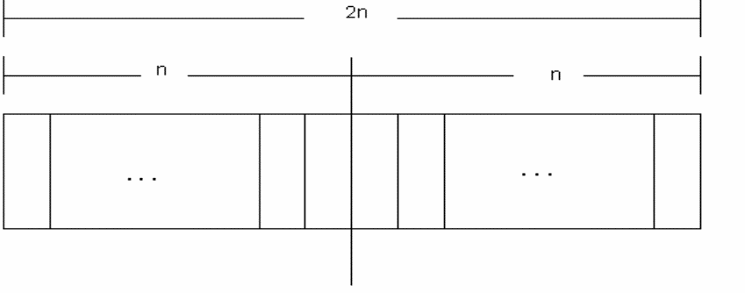
Examples
The language of strings of length 2, defined over Σ={a,b} is L={aa, ab, ba, bb} i.e. number of strings = 2²
The language of strings of length 3, defined over Σ={a,b} is
L={aaa, aab, aba, baa, abb, bab, bba, bbb} i.e. number of strings = 2³
To calculate the number of palindromes of length(2n), consider the following diagram,
which shows that there are as many palindromes of length 2^{n} as there are the strings of length n i.e. the required number of palindromes are 2^{n}.

Slide 24
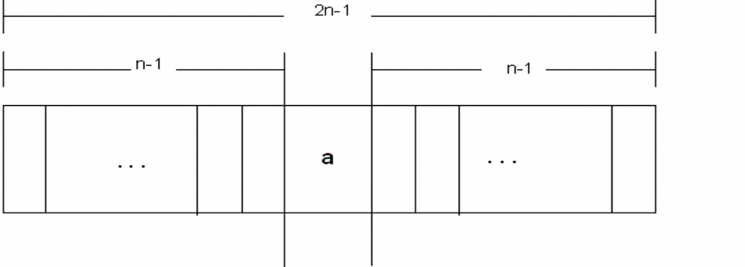
To calculate the number of palindromes of length (2n-1) with ‘a’ as the middle letter, consider the following diagram,
which shows that there are as many palindromes of length 2n-1 as there are the strings of length n-1 i.e.the required number of palindromes are 2^{n-1}.
Similarly the number of palindromes of length 2n-1, with ‘ b ’ as middle letter, will be 2^{n-1} as well. Hence the total number of palindromes of length 2n-1 will be 2^{n-1} + 2^{n-1} = 2 (2^{n-1})= 2^{n}

Slide 25
Kleene Star Closure
Given Σ, then the Kleene Star Closure of the alphabet Σ, denoted by Σ*, is the collection of all strings defined over Σ, including Λ. It is to be noted that Kleene Star Closure can be defined over any set of strings.
Examples
  If Σ = {x}
  Then Σ* = {Λ, x, xx, xxx, xxxx, ….}
  If Σ = {0,1}
  Then Σ* = {Λ, 0, 1, 00, 01, 10, 11, ….}
  If Σ = {aaB, c}
  Then Σ* = {Λ, aaB, c, aaBaaB, aaBc, caaB, cc, ….}
Note
Languages generated by Kleene Star Closure of set of strings, are infinite languages. (By infinite language, it is supposed that the language contains infinite many words, each of finite length).

Slide 26
PLUS Operation
Plus Operation is same as Kleene Star Closure except that it does not generate ∆ (null string), automatically
Example
If Σ = {0,1}
Then Σ⁺ = {0, 1, 00, 01, 10, 11, ….}
If Σ = {aab, c}
Then Σ⁺ = {aab, c, aabaab, aabc, caab, cc, ….}

Slide 27
Remark
It is to be noted that Kleene Star can also be operated on any string i.e. a* can be considered to be all possible strings defined over {a}, which shows that a* generates Λ, a, aa, aaa, …
It may also be noted that a⁺ can be considered to be all possible non empty strings defined over {a}, which
shows that a⁺ generates a, aa, aaa, aaaa, …

Slide 28
Recursive definition of languages
The following three steps are used in recursive definition
Some basic words are specified in the language.
Rules for constructing more words are defined in the language.
No strings except those constructed in above, are allowed to be in the language.

Slide 29
Example
Defining language of INTEGER
Step 1 : 1 is in INTEGER.
Step 2 : If x is in INTEGER then x+1 and x-1 are also in INTEGER.
Step 3 : No strings except those constructed in above, are allowed to be in INTEGER

Slide 30
Example
Defining language of EVEN
Step 1 : 2 is in EVEN.
Step 2 : If x is in EVEN then x+2 and x-2 are also in EVEN.
Step 3 : No strings except those constructed in above, are allowed to be in EVEN.

Slide 31
Example
Defining the language factorial
Step 1 : As 0!=1, so 1 is in factorial.
Step 2 : n!=n*(n-1)! is in factorial.
Step 3 : No strings except those constructed in above, are allowed to be in factorial

Slide 32
Defining the language PALINDROME, defined over Σ = {a,b}
Step 1 : a and b are in PALINDROME
Step 2 : if x is palindrome, then s(x)Rev(s) and xx will also be palindrome, where s belongs to Σ*
Step 3 : No strings except those constructed in above, are allowed to be in palindrome

Slide 33
Defining the language {a^{n}b^{n} }, n=1,2,3,… , of strings defined over Σ={a,b}
Step 1 : ab is in {a^{n}b^{n}}
Step 2 : if x is in {a^{n}b^{n}}, then axb is in {a^{n}b^{n}}
Step 3 : No strings except those constructed in above, are allowed to be in {a^{n}b^{n}}

Slide 34
Defining the language L, of strings ending in a , defined over Σ ={a,b}
Step 1 : a is in L
Step 2 : if x is in L then s(x) is also in L, where s belongs to Σ*
Step 3 : No strings except those constructed in above, are allowed to be in L

Slide 35
Defining the language L, of strings beginning and ending in same letters , defined over Σ ={a, b}
Step 1 : a and b are in L
Step 2 : (a)s(a) and (b)s(b) are also in L, where s belongs to Σ*
Step 3 : No strings except those constructed in above, are allowed to be in L

Slide 36
Defining the language L, of strings containing aa or bb , defined over Σ={a, b}
Step 1 : aa and bb are in L
Step 2 : s(aa)s and s(bb)s are also in L, where s belongs to Σ*
Step 3 : No strings except those constructed in above, are allowed to be in L

Slide 37
Defining the language L, of strings containing exactly one a, defined over Σ={a, b}
Step 1 : a is in L
Step 2 : s(aa)s is also in L, where s belongs to b*
Step 3 : No strings except those constructed in above, are allowed to be in L

Slide 38
Link
en.wikipedia.org/wiki/Automata_theory
www.britannica.com/EBchecked/topic/44836/automata-theory

